Slide 1

Term Project:
Systematic Review of a Biomaterial
Dr. Sarkis SÖZKES
ssozkes@fgcu.edu

Slide 2
Contents
Introduction: Term Project Overview
Understanding Biomaterials: A Definition
Introduction to Systematic Literature Search
PRISMA Flow Chart: An Overview
Phase 1: Identification - Developing Search Strategies
Phase 2: Screening - Eligibility Criteria and Selection
Phase 3: Eligibility - Full-Text Review and Inclusion
Phase 4: Included - Data Extraction and Synthesis
Application of PRISMA to Biomaterial Research
Challenges and Considerations in Systematic Reviews
Expected Outcomes and Impact of the Project
Conclusion & Future Directions

Slide 3

Introduction: Term Project Overview
Project Scope and Objectives
Presentation Overview and Structure
This project aims to conduct a comprehensive systematic review, culminating in a final report detailing findings and implications. It serves as a foundational exercise in applying rigorous research methodologies to a specific scientific domain.
The presentation will outline the key steps involved in executing a systematic review, from initial literature search to data synthesis, with a specific focus on biomaterials research.

Slide 4
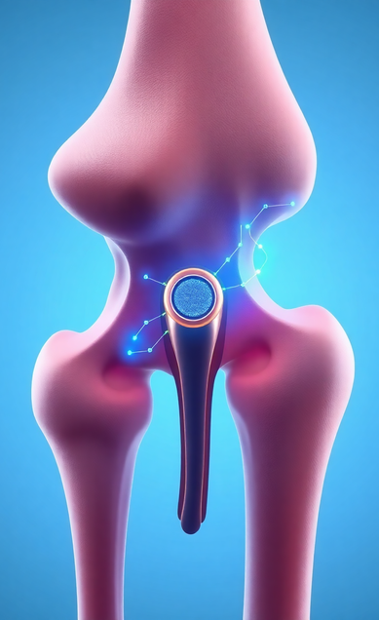
Understanding Biomaterials: A Definition
1
2
Defining Biomaterials
Properties and Applications
Biomaterials are substances engineered to interact with biological systems for a medical purpose, either therapeutic or diagnostic. They can be synthetic or natural in origin and are designed to perform, augment, or replace a natural function.
Key characteristics include biocompatibility (not eliciting adverse host responses), desired mechanical properties, and biodegradability/stability, depending on the application. Examples range from implants and prosthetics to drug delivery systems and tissue engineering scaffolds.

Slide 5

Introduction to Systematic Literature Search
Purpose and Importance
Key Principles and Methodologies
A systematic literature search is a rigorous and transparent method for identifying, appraising, and synthesizing all relevant studies on a specific research question. It minimizes bias and provides a reliable basis for evidence-based conclusions.
This approach involves clearly defined search strategies, explicit inclusion/exclusion criteria, and methodical data extraction and synthesis, ensuring reproducibility and comprehensiveness.

Slide 6

PRISMA Flow Chart: An Overview
What is PRISMA?
The PRISMA Flow Chart: Purpose and Structure
PRISMA (Preferred Reporting Items for Systematic Reviews and Meta-Analyses) is an evidence-based minimum set of items for reporting in systematic reviews and meta-analyses. It helps authors report a complete and transparent account of their research.
The PRISMA flow chart is a visual representation of the flow of information through the different phases of a systematic review. It maps out the number of records identified, included, and excluded, and the reasons for exclusions.

Slide 7

Phase 1: Identification - Developing Search Strategies
1
Objective of Phase 1
2
Strategy Development and Database Searching
This initial phase focuses on identifying potential studies from various sources, primarily electronic databases (e.g., PubMed, Scopus, Web of Science). The goal is to cast a wide net to capture all potentially relevant literature.
Developing a comprehensive and sensitive search strategy involves selecting appropriate keywords (including MeSH terms and synonyms), Boolean operators (AND, OR, NOT), and applying filters (e.g., publication dates, study types). Iterative refinement of search terms is often necessary.

Slide 8

Phase 2: Screening - Eligibility Criteria and Selection
Purpose of Screening
Screening involves reviewing the titles and abstracts of identified studies against predefined inclusion and exclusion criteria. This step aims to quickly filter out irrelevant studies while retaining all potentially relevant ones for further assessment.
Establishing and Applying Eligibility Criteria
Inclusion criteria specify the characteristics studies must possess to be included (e.g., specific study design, population, intervention, outcome). Exclusion criteria define characteristics that would make a study ineligible. Decisions are typically made by two independent reviewers to reduce bias.

Slide 9



Phase 3: Eligibility - Full-Text Review and Inclusion
Objective of Full-Text Review
Rigorous Application of Inclusion/Exclusion Criteria
In this phase, full-text articles of all studies that passed the initial screening are retrieved and thoroughly assessed for eligibility against the detailed inclusion and exclusion criteria. This is a critical step where methodological quality and relevance are closely scrutinized.
The detailed eligibility criteria, established during the protocol development, are rigorously applied. Any discrepancies or uncertainties during this phase are resolved through discussion among reviewers or by consulting a third party. Documenting reasons for exclusion at this stage is crucial for the PRISMA flow diagram.

Slide 10

Phase 4: Included - Data Extraction and Synthesis
Synthesizing Extracted Data and Reporting Findings
Systematic Data Extraction
Once studies are deemed eligible, relevant data are systematically extracted from each included article using pre-designed data extraction forms. This ensures consistency and captures all necessary information for answering the research question.
Data synthesis involves combining and interpreting the extracted data to answer the systematic review's research question. This can range from a qualitative synthesis (narrative summary) to a quantitative synthesis (meta-analysis), depending on the homogeneity and nature of the studies.

Slide 11

Application of PRISMA to Biomaterial Research
Evidence-Based Assessment of Biomaterials
Systematic reviews provide robust evidence on the efficacy, safety, and performance of biomaterials in various clinical applications. They can identify gaps in current research, assess existing technologies, and inform future material development.
Enhancing Transparency and Reproducibility in Biomaterial Research
Applying PRISMA ensures transparency and reproducibility in reviews of biomaterial research, enhancing the reliability of conclusions regarding material properties, biological interactions, and clinical outcomes. This aids in standardizing reporting across the field.

Slide 12

Challenges and Considerations in Systematic Reviews
Common Challenges Encountered
Important Considerations for Rigor and Validity
Challenges include the heterogeneity of biomaterial types and applications, variability in study designs, and the rapid evolution of the field, making comprehensive searches and synthesis complex. Ensuring consistency in terminology and reporting across studies is also difficult.
Considerations involve managing large volumes of data, ensuring inter-rater reliability during screening and data extraction, and critically appraising the methodological quality of diverse studies. Addressing publication bias and selectively reporting positive outcomes is also paramount.

Slide 13
Expected Outcomes and Impact of the Project
Skill Development and Contribution to Future Research
Comprehensive Understanding and Evidence Base
The project is expected to yield a comprehensive understanding of the selected biomaterial topic, providing evidence-based insights for future research or clinical practice. It will serve as a foundational piece of literature for further inquiry.
Beyond the specific findings, the project aims to demonstrate proficiency in systematic review methodology, critical appraisal skills, and effective scientific communication, providing a strong foundation for future research endeavors.

Slide 14
Conclusion & Future Directions
Recommendations for Future Research and Directions
Summary of Learnings
Future work could involve expanding the scope to include meta-analysis if appropriate data are found, exploring new biomaterial applications, or integrating real-world evidence. Continued refinement of search strategies and collaboration are key for advancing biomaterials research.
This project has provided a rigorous framework for conducting systematic reviews, highlighting the importance of meticulous planning, execution, and transparent reporting using tools like PRISMA.

